Slide 1
Adding a clickable link for the logo
In Primo VE NDE
Yoel Kortick | May 2026

Slide 2
Agenda
  Introduction
  The steps to add a clickable link for the logo
  A live demo to add a clickable link for the logo

Slide 3

Introduction

Slide 4
Introduction
The institution can quickly and easily specify a link that opens a page when users click the logo.
If no URL is configured, the Discovery home page is displayed when a user clicks the logo.

Slide 5
The steps to add a clickable link for the logo

Slide 6
The steps to add a clickable link for the logo
To add a clickable link for the logo:
  Access “Configure Views”
  Edit the View
  Select the “General” tab
  In the “Logo Clickable URL” field specify the redirection URL

Slide 7
A live demo to add a clickable link for the logo

Slide 8
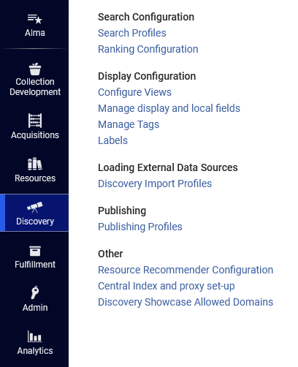
A live demo to add a clickable link for the logo
Access “Configure Views”

Slide 9
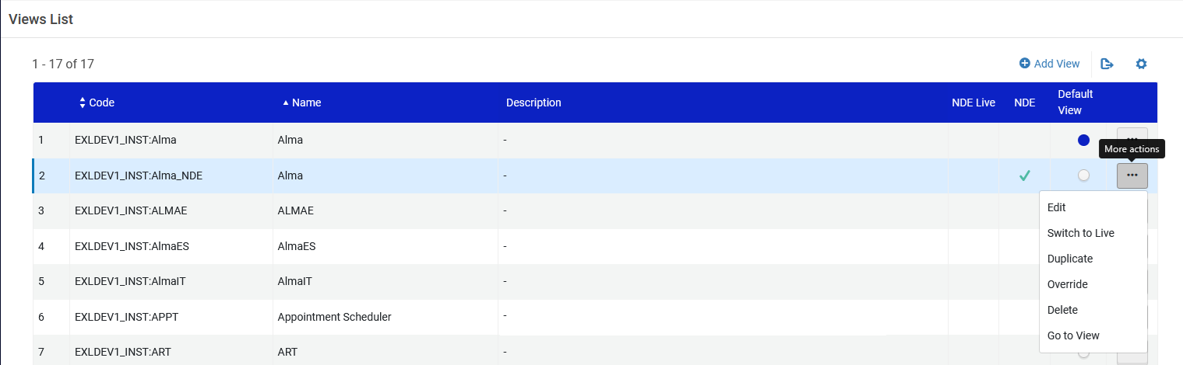
A live demo to add a clickable link for the logo
Edit the view

Slide 10
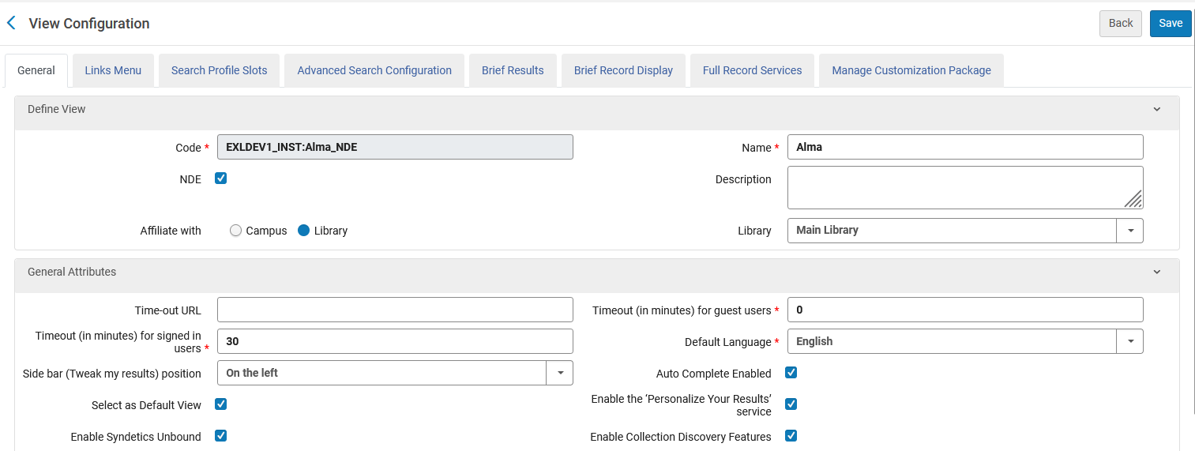
A live demo to add a clickable link for the logo
Select the “General” tab
Note that this is a partial screenshot of the “General” tab

Slide 11
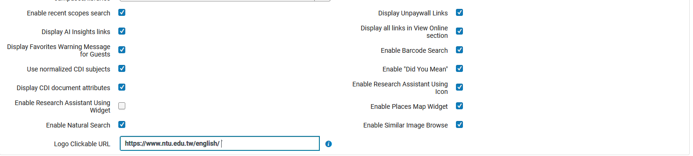
A live demo to add a clickable link for the logo
In the “Logo Clickable URL” field specify the redirection URL
The user will be redirected to https://www.ntu.edu.tw/english/ (The National Taiwan University)
Note that before the advent of Primo VE NDE the “Logo Clickable URL” field was in the “Manage Customization Package” tab in the “Upload Logo” section.

Slide 12
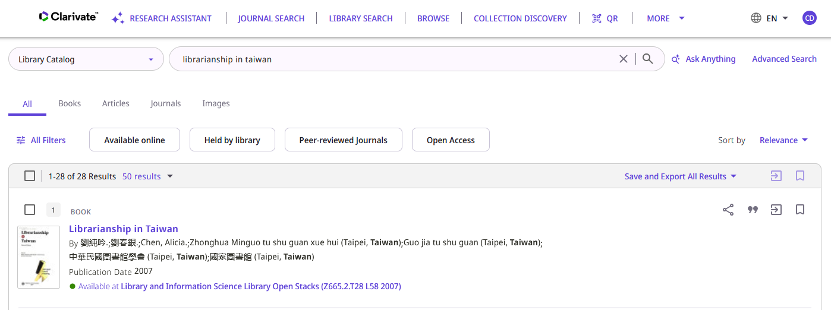
A live demo to add a clickable link for the logo
To test this the end user will now click the logo in Primo VE NDE
End user in Primo VE NDE will click the logo

Slide 13
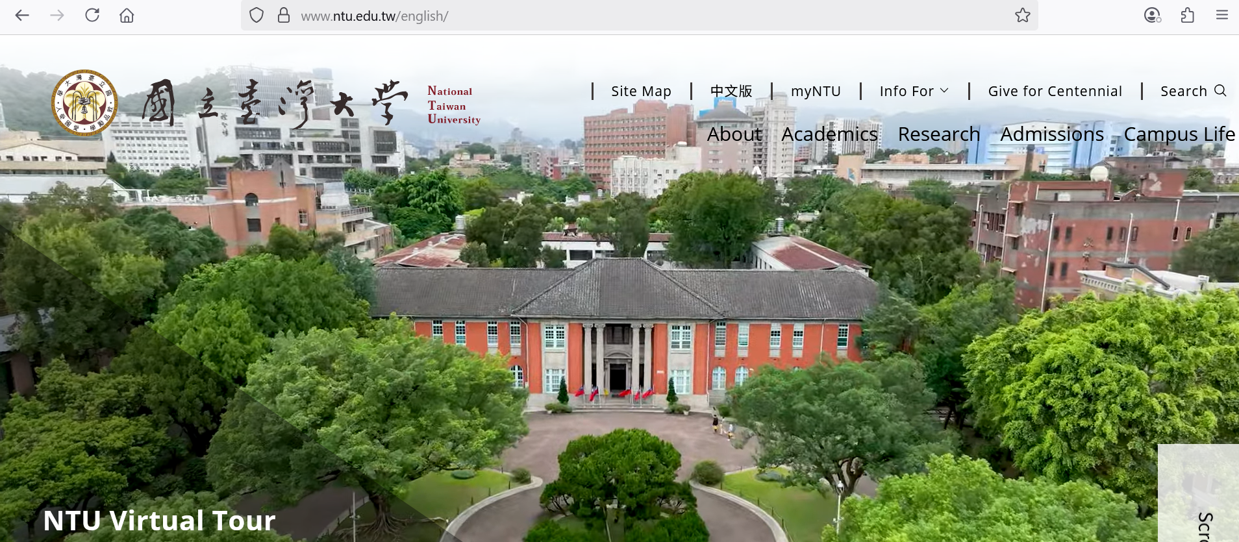
A live demo to add a clickable link for the logo
The end user is correctly redirected to https://www.ntu.edu.tw/english/ which is what we defined

Slide 14
Thank You

